Slide 1
Flexible theory of investment
John Wick

Slide 2
INTRODUCTION
The theory of flexible accelerator has been developed in various forms by Seneri, Goodwin, Koik and Junankar. But the most accepted approach was adopted by Koik. This theory is also known as the capital stock adjustment model.

Slide 3
MEANING
The flexible accelerator theory eliminates one of the main weaknesses of the simple acceleration theory, namely that the capital reserve is adjusted optimally without any delay. In a flexible accelerator, there are lags in the adjustment process between the level of production and the level of capital stock. Junankar has discussed the lags in the adjustment between production and capital stock. He explains them at the organizational level and extends them to the overall level

Slide 4
If the demand for the product has increased:
Decision-making lag: The company will use its inventory and then use its capital reserves more intensively. If the increase in demand for production is large and lasts for some time, the company will increase the demand for capital reserves.

Slide 5
Administrative lag - organizing the capital.
Financial resilience – Raising funds to buy capital
Distribution regression - between formalizing capital and its distribution.

Slide 6
"Assuming that different companies have different results and have a distribution regression, the effect of the increase in demand on capital stocks on the whole is distributed over time. This implies that the capital stock is dependent on all previous production conditions.
K_{t} = f ( Y_{t}, Y_{t-1}……., Y_{t-n})

Slide 7
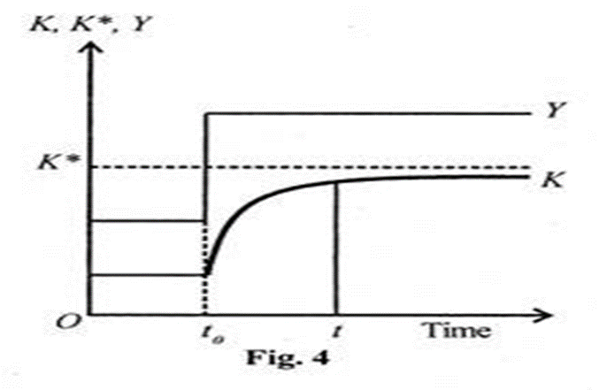

Slide 8
This is illustrated in the figure, in the initial t0 period, there is a constant correlation between the capital reserve and the level of production.
As the demand for production increases, the capital stock gradually increases after the end and the supply lags behind as shown by the K curve depending on the previous production conditions.
The increase in output is shown by the curve t. The point line K is the optimal capital stock, which is equal to the actual capital stock K.

Slide 9
THANK YOU

